Slide 1
Hackathon Project
Team Name : Duo
Members : Anurag Mishra and Varad Ijantkar
Organizer: S.I.t.S Computer science department

Slide 2
Introduction
Our project is to build a website builder
It also introduces the concept of version control in GUI and real time collaborators (W.I.P.)
It also provides the front end code (HTML,CSS,Javascript) of the website to users.

Slide 3
Dependencies
Express
Nodemon
Bcryptjs
Jsonwebtoken
Mongoose

Slide 4

Photos

Slide 5
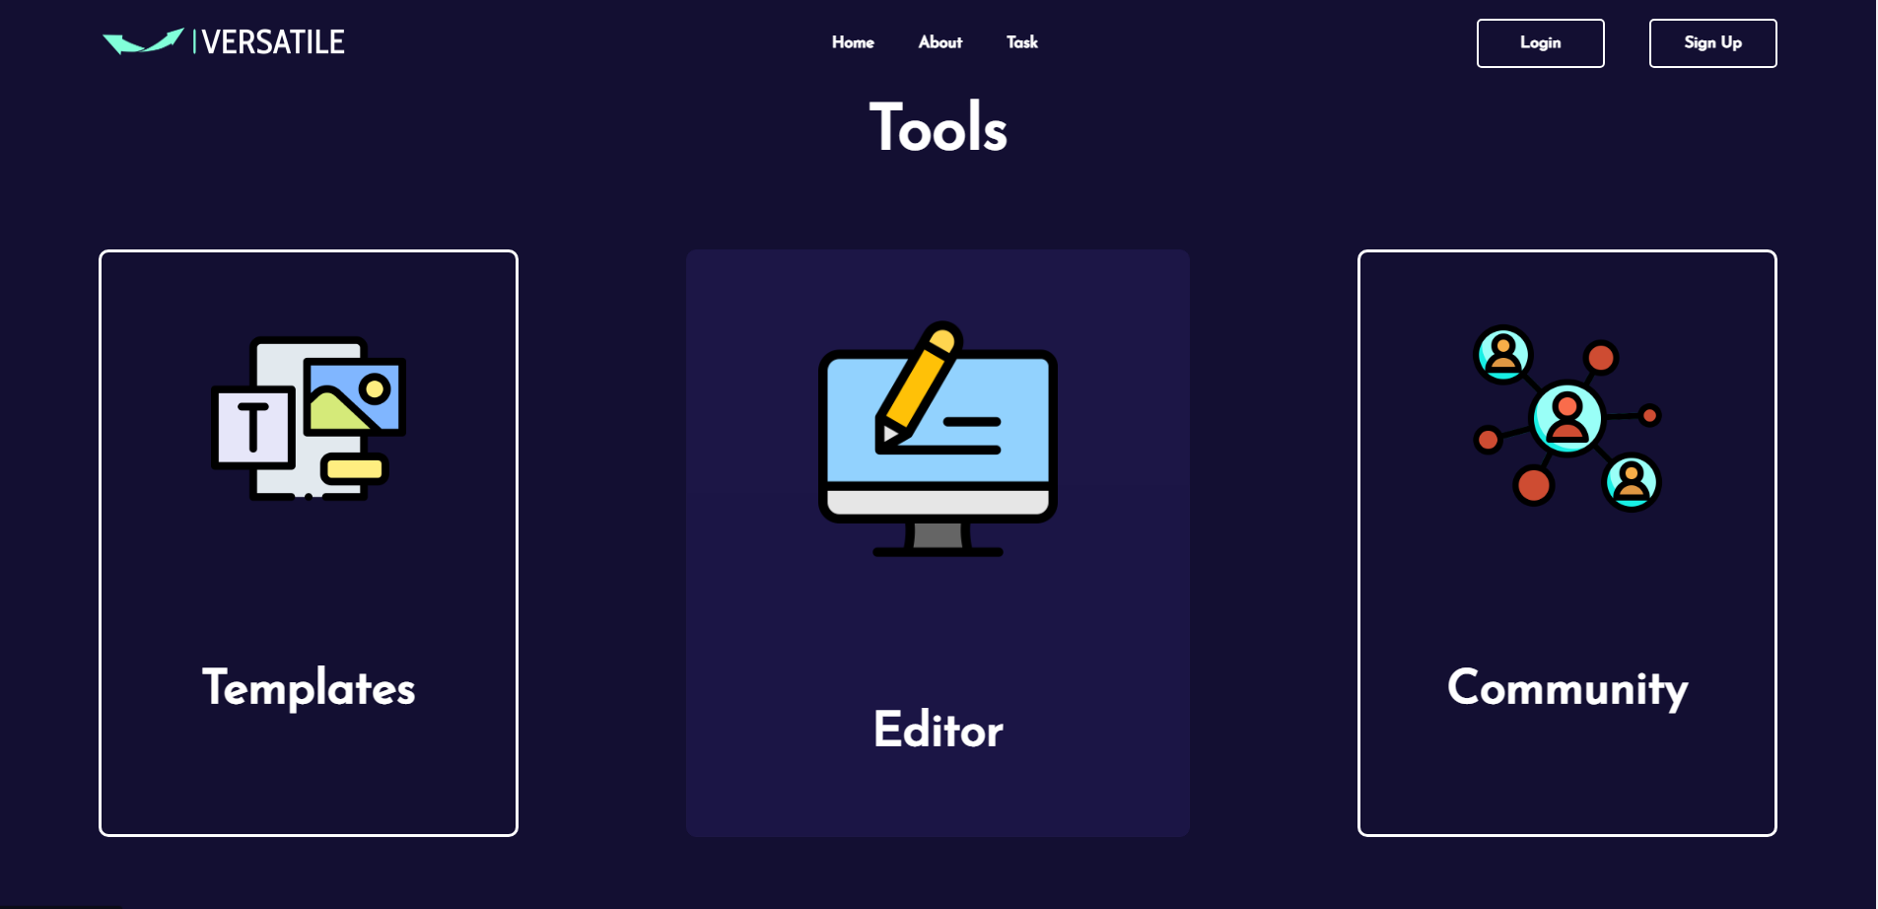

Slide 6
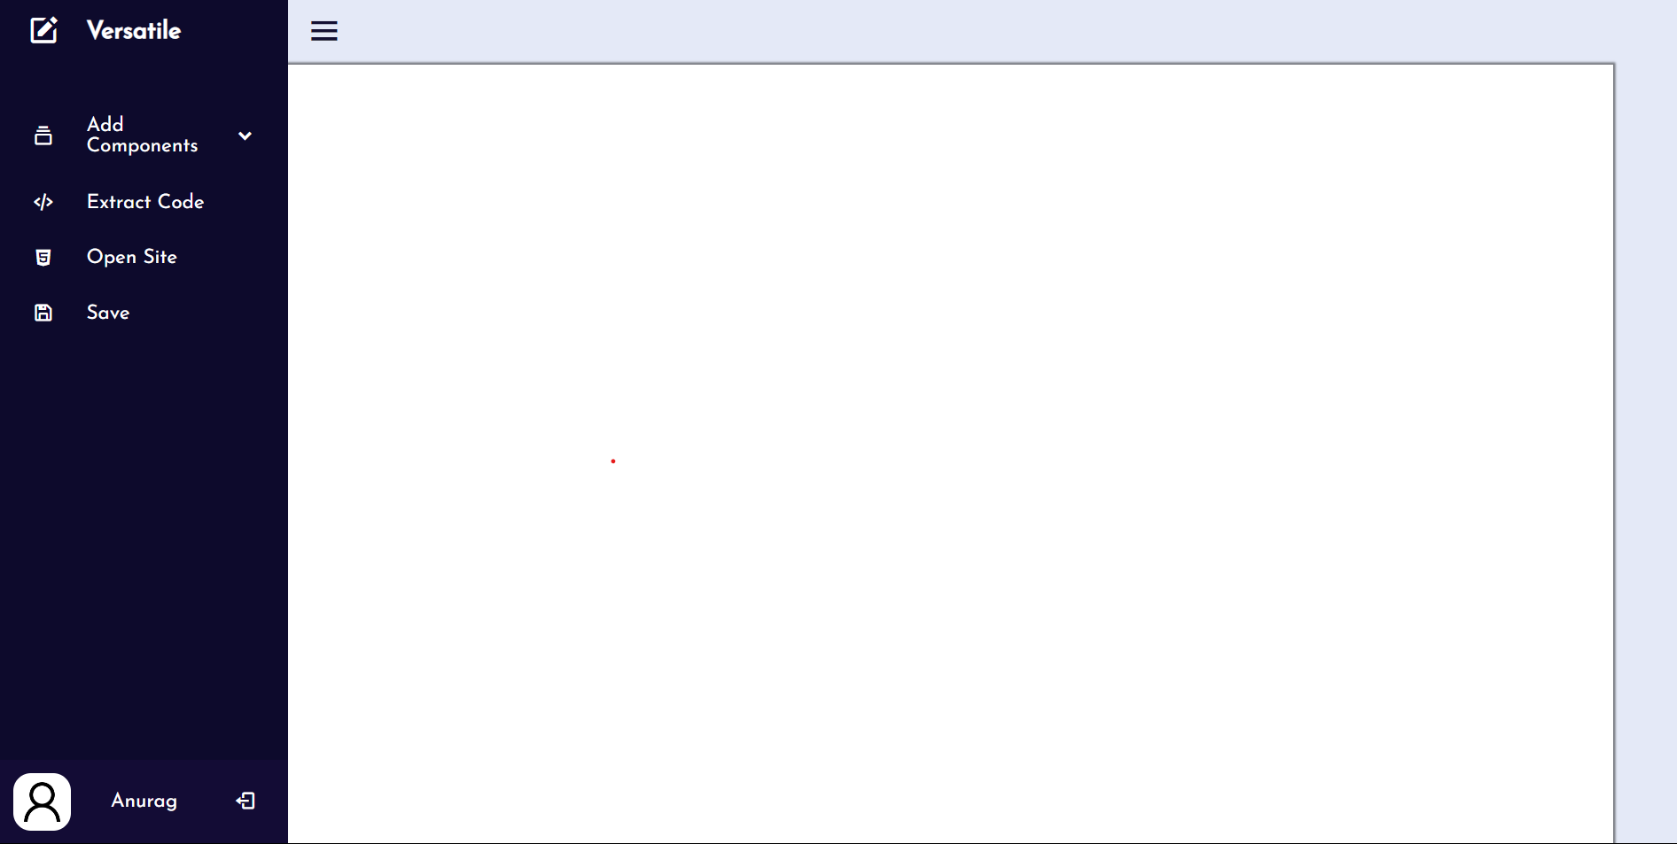

Slide 7
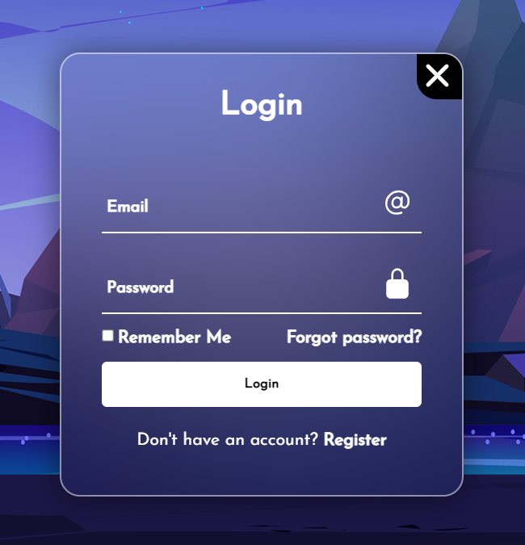
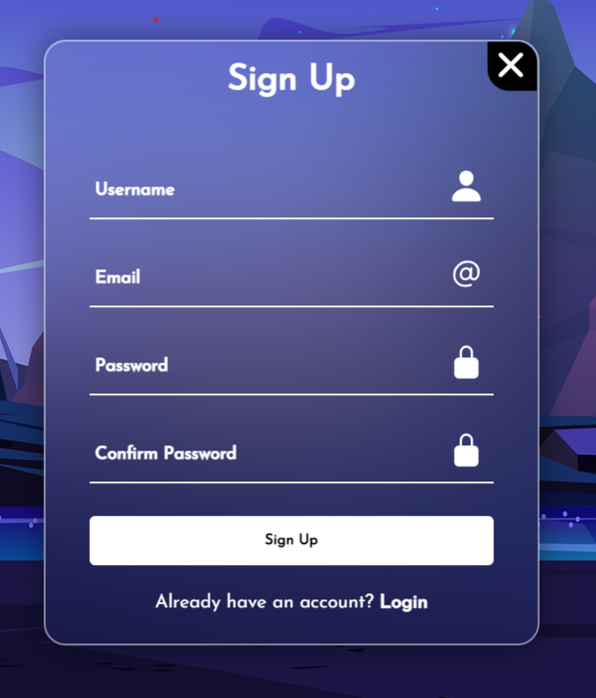

Slide 8


Slide 9
